Slide 1


The Mantid Project:
Notes from an international software collaboration
Nick Draper
Tessella

Slide 2
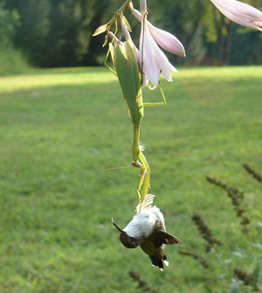
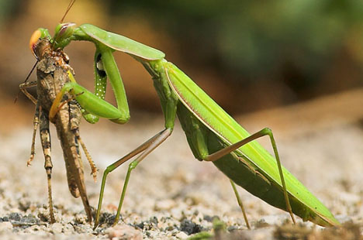
Overview
Mantid Introduction
Why collaborate?
Collaboration Models
ISIS - SNS & HFIR collaboration
  Organisation
  Benefits
  Lessons Learned

Slide 3
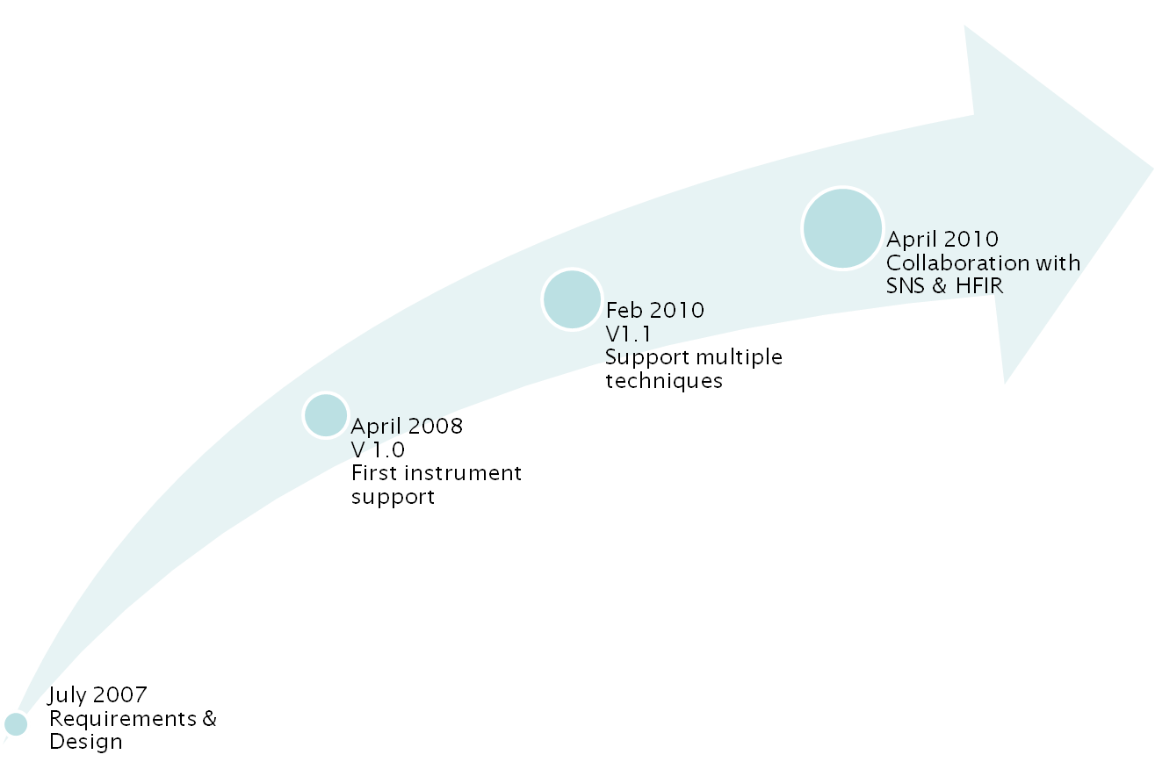
Project History

Slide 4

Project Goals
Goals
  Consolidate the data analysis software for neutron scattering without restricting the needs of the instrument scientists
Key requirement
  Create a Data Analysis framework
    not instrument or technique/dependent
  Cross-platform
    Windows, Linux, Mac
  Easily extensible
  Freely redistributable

Slide 5
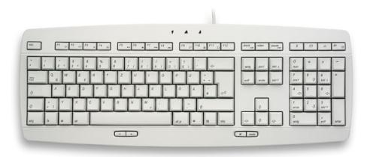

Framework vs individual applications
Less time spent developing input and output routines
More time on scientific algorithms
Cross benefits from other groups
Lower support requirements
Better documentation and training
Fewer single points of failure
Structure for further developments

Slide 6

Framework flexibilty
Instrument independence
  Virtual instrument defined
    Loaded from xml definition
      Location, rotation and shape of every pixel
      Sample
      Source
Technique independence
  Algorithms
    Unit Reduction and analysis steps
  Workflow scripts
    Chain algorithms to perform a reduction workflow

Slide 7

Framework flexibilty
Plug in extensions
  Common
    Algorithms – C++ or Python
    Instruments
    Workflow scripts
    Custom user interfaces
    Custom algorithm dialogs
  Less frequent
    Workspaces
    Units
    Optimisation
      Functions & models
      Optimisers & cost functions
      Constraints

Slide 8
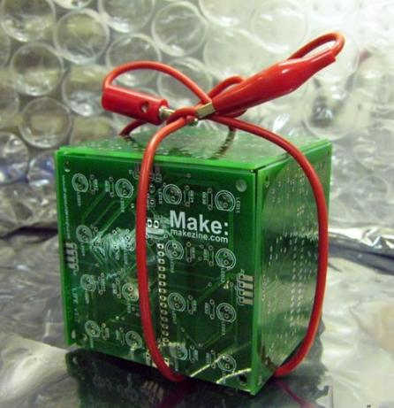
Open Source
GPL v3
  Free to use
  Source code openly available
  Results cannot be sold
    Unless you own the copyright
Good basis for collaboration
Sharing benefits to wider community
Why not LGPL, BSD etc?

Slide 9
Future Development Scope
Reduction
Analysis
Spallation & Reactor
Technique support
  Inelastic
    Direct
    Indirect
  Diffraction
    Powder
    Engineering
    Single Crystal
    Diffuse scattering
  Disordered Materials
  Large Scale Structures
    Small angle
    Reflectometry
  Muons

Slide 10
Collaboration Benefits
Why Collaborate?
  Solve big problems
  Cover a wide scope
  ↑ access to skills and talents
  Reduce costs
  Access to existing code
  Improved support
All parties should benefit

Slide 11

Collaboration Challenges
Why Collaborate?
  Larger development team
  ↑ induction
  ↑ communication
  ↑ project structure
  Generic solutions take time
  ↑ documentation
It is important to minimise these effects

Slide 12

Collaboration Models
Many possible models
Several used within Mantid
  Open contributions - Informal Anarchy
  User donated code
  Joint distributed team
  Application integration
Important to pick the right model for the situation

Slide 13

Open Contributions - Informal Anarchy
Key Features
  People choose their own priorities
  Anyone can submit code
  Immediately available to all
Advantages
  Very lightweight
Drawbacks
  Negative effect on quality
  Likely to repeat work
Use in Mantid
  User script library

Slide 14

User donated code
Key Features
  Users submit code to the dev team
  Dev team adopt the code
    Review & Refactor
    Test
    Document
Advantages
  High quality additions to functionality
Drawbacks
  Significant dev team involvement
Use in Mantid
  User supplied algorithms and key scripts

Slide 15
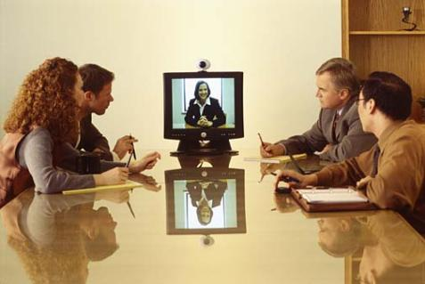
Joint distributed team
Key Features
  Single project management lead
  Geographically separated, but joint
  dev teams
Advantages
  Consistent, planned development
  Increased support hours
Drawbacks
  Increased communication
  Initially introduction of a whole dev team
Use in Mantid
  ISIS – SNS Development

Slide 16

Application integration
Key Features
  Integration with well known tools
  Smooth transfer to/from Mantid
  Rapid increase in functionality
Advantages
  Can be simple file format support
  Avoids reinventing the wheel
Drawbacks
  Imperfect user experience
  Lack of direct control
Use in Mantid
  GSAS, Fullprof & other tools

Slide 17
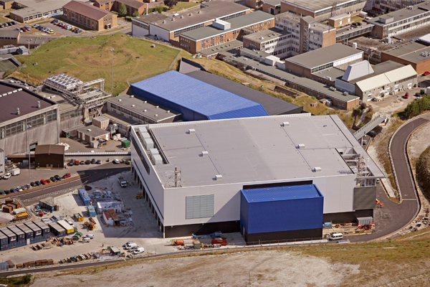
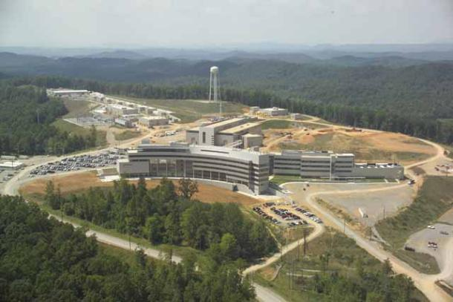
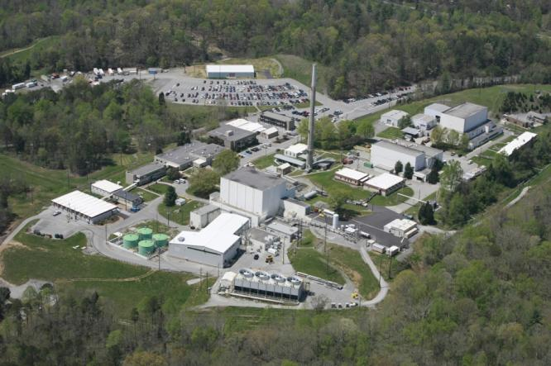
ISIS - SNS & HFIR collaboration

Slide 18
SNS Collaboration Timeline
March 2009 - ICNS 2009
  Initial meeting & discussions
Oct 2009 - Due Diligence visit
  Week with the development team
  Discussions with several scientist users
  Future plans
  Areas of common interest
Jan 2010 - Go / No Go decision
Apr 2010 - Memorandum of Understanding
May 2010 - Joint development begins
Aug 2010 – Initial SNS & HFIR support

Slide 19
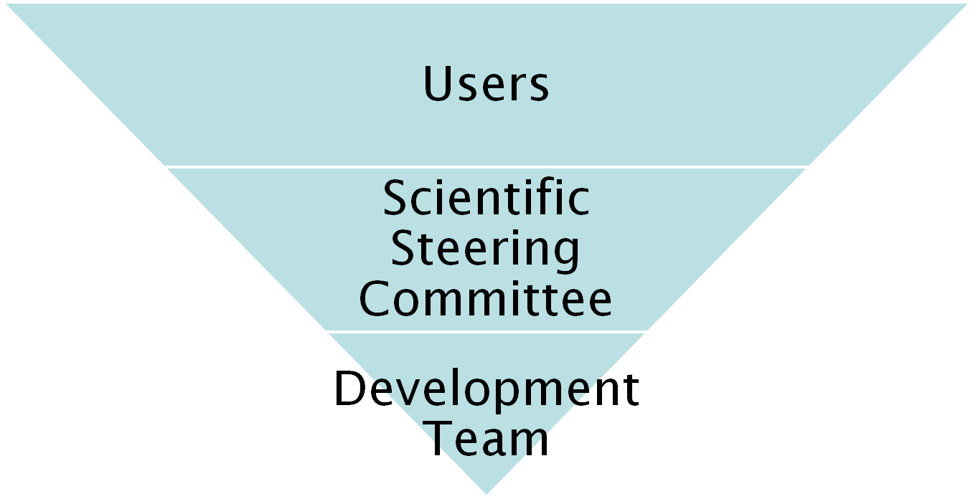
Previous Project Organisation
27 beamlines, 1600 users
9 Key scientists representing every beamline.
PM &
7 Developers

Slide 20
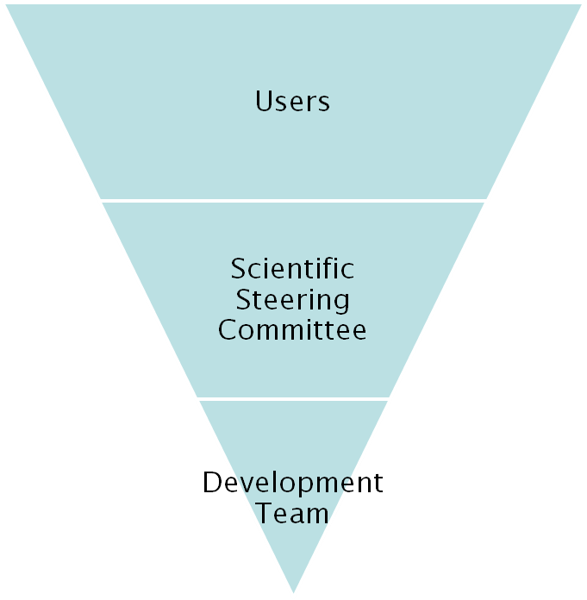
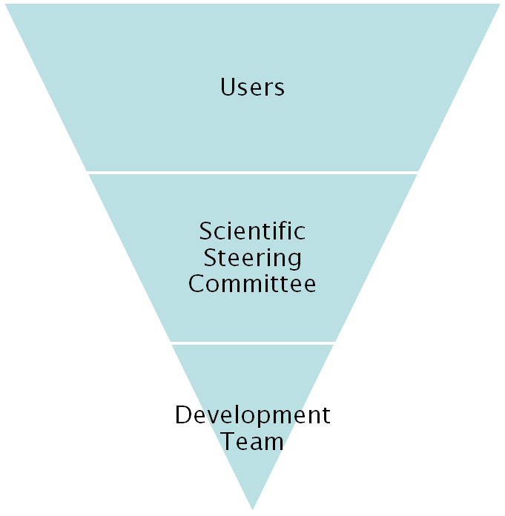
Project Organisation
ISIS
SNS/HIFR

Slide 21
Team Structure
Joint project management board
Two scientific steering committees
One project manager
  Control overall project direction
  Final point of decision making
Local Development Team Leaders
One Development Team
  7 FTE staff at ISIS
  5+ FTE staff at SNS and still growing

Slide 22



Continuous Integration Environment
Deploy to
Download site
Mantid Project Wiki
Automated
System test
SVN
Repository
Build + unit test
-Linux
-Mac OSX
-Windows 32
-Windows 64
trac
Issue
tracking
system
Developers

Slide 23
Communication
Face to face meetings
  PM 3-4yr
  Developer visit program
  Developer workshops
Developer Transfer
  ISIS lead developer transferred to US
Easy communication channels
  Developer email list
  Skype
  Phone
  Screen sharing
  Video conferencing

Slide 24
ISIS -> SNS wins
Robust framework
  Common development structure
  Multithreaded performance
  Documentation and training
  Automated build, test and deployment
Algorithms
  Over 100 algorithms already developed
Development support
  help

Slide 25
SNS -> ISIS wins
Improvements to build process
  Cmake, Hudson
Event Workspaces
Event Filtering
  Currently by time
  Will expand
Improved python code framework
New file format support
  NxSPE
  Event Nexus

Slide 26
Lessons Learned
Developer documentation
  Need to rapidly induct several new developers
  Will not be good enough
Communication
  Has to be encouraged
  Will take some time
Personal relationships
  Are key to working together in a team
High level support is essential
No two facilities are the same
  Archive structure
  Information catalog

Slide 27
Lessons Learned
Minor irritations
  You may have learned to live with them
  Will be much more irritating to new developers
    Make use of this enthusiasm
Development Environments
  Will differ across facilities
  Set up can be painful
  Don’t let issues linger
Design
  Consider implications
  Design for flexibility

Slide 28
Further Information
Project Web Page
  www.mantidproject.org
Project Introduction Document
  http://svn.mantidproject.org/mantid/trunk/Documents/Requirements/Project%20Introduction%20Document.doc
User Requirements Document
  http://svn.mantidproject.org/mantid/trunk/Documents/Requirements/URD.doc
Architectural Design Document
  http://svn.mantidproject.org/mantid/trunk/Documents/Design/Architecture%20Design%20Document.doc

Slide 29



Architectural Design - Overview
Instrument log files
MantidScript
Command line & Scripting interface
RAW data files
Mantid Framework
API
Algorithms
Workspaces
MantidPlot Graphing and analysis
NEXUS data files
User Defined
User Defined
Matlab Interface
DAE direct access
Future Instrument specific UI
Future Instrument specific UI

